Slide 1



DESIGNING AN APP FOR SCREENING OF
POSSIBLE MENTAL HEALTH ISSUES
GUIDED BY
MS. SHREELA PAREEK
PRESENTED BY-
KAPIL KUMAR SINGH (2100290120092)
PIYUSH MISHRA (2100290120118)
NAYAN PATHAK (2100290120112)
KAPIL CHAUHDHARY (2100290120091)

Slide 2

Problem Statement
Mental Health Crisis Among Youth
Rising levels of anxiety, depression, and phobias, especially in adolescents and young adults
Increased societal pressure, academic stress, and digital overload contribute to the growing concern.
Limitations of Traditional Therapy
Accessibility: Many individuals, especially in rural or underprivileged areas, lack access to trained professionals.
Stigma: Social stigma prevents people from seeking help openly.
Engagement: Conventional therapy methods often feel impersonal or unrelatable to tech-savvy younger audiences.
Need for Technological Solutions
There is a critical need to enhance therapy delivery using technologies that resonate with today’s generation.
The integration of AI and VR presents a promising opportunity to bridge gaps in access, engagement, and personalization.

Slide 3
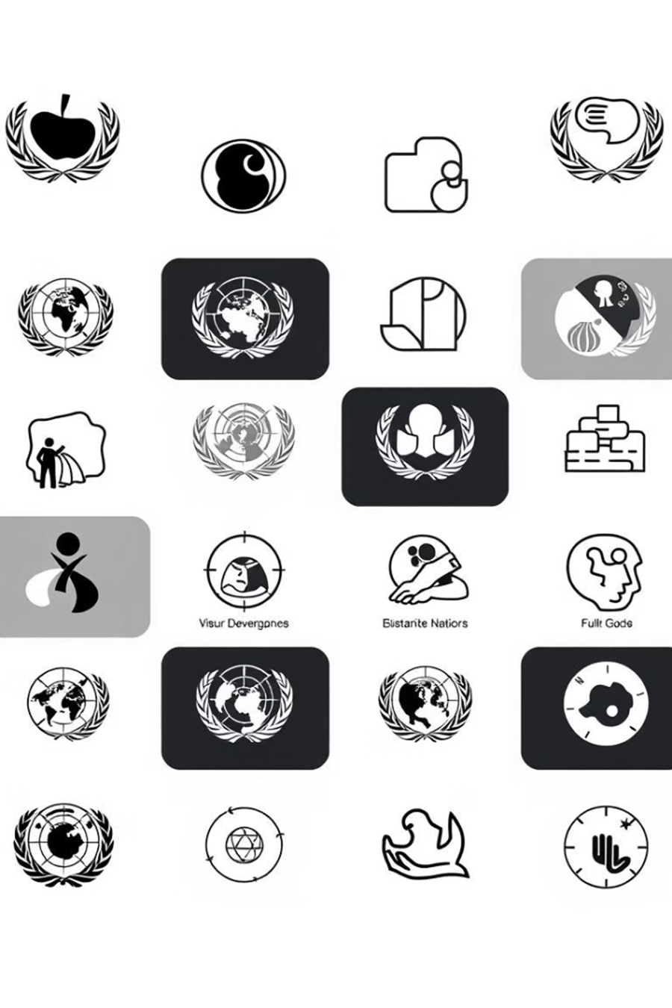
Alignment with UN Sustainable Development Goals (SDGs)
SDG 3: Good Health and Well-Being
Promote mental health and well-being through innovative therapy solutions.
SDG 9: Industry, Innovation, and Infrastructure
Leverage advanced technologies like VR and AI to create impactful solutions.
SDG 17: Partnerships for the Goals
Collaborate with mental health organizations and tech communities for global reach.

Slide 4

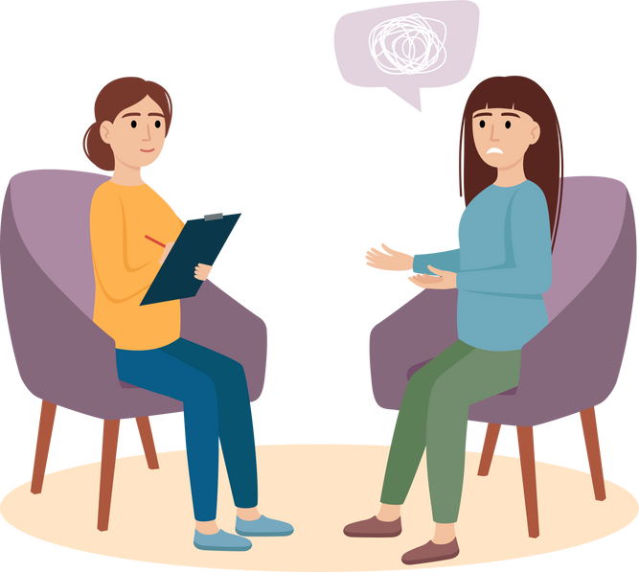
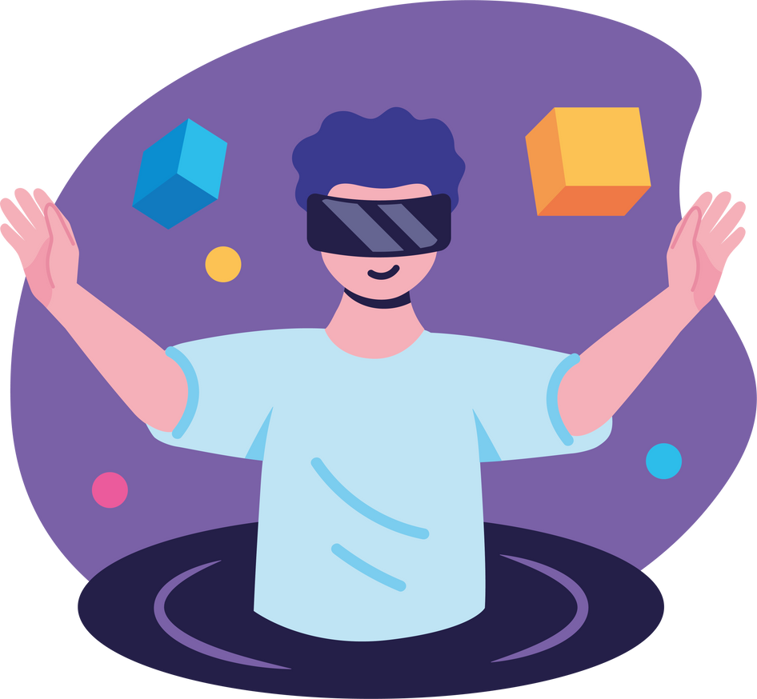
Objective
Primary
Goal
To explore and evaluate an accessible, adaptive, and immersive mental health platform using Virtual Reality (VR) and Artificial Intelligence (AI) to support individuals suffering from anxiety, phobias, and other p.sychological challenges.
Virtual Reality
Artificial Intelligence
Peer/Professional Support
🧠 Integrate VR Exposure Therapy (VRET)
🤖 Implement AI-Based Emotional Analysis
💬 Enable Peer-Support Chatrooms

Slide 5
Literature Review
🧠 Traditional Diagnosis of Mental Health Disorders
SCL-90-R: Widely used but lengthy and time-consuming
Shortened versions like SCL-14 reduce time but compromise diagnostic coverage
Relies on self-reporting, leading to bias and low engagement
🤖 AI in Diagnosis and Treatment
AI-powered chatbots use Natural Language Processing (NLP) for dynamic conversations
Real-time emotion detection through tone and sentiment analysis
Enables personalized treatment plans (e.g. CBT, meditation, VR therapy).
🎮 VR for Mental Health Therapy
VR enables controlled exposure to fear-inducing stimuli (e.g. heights, public speaking)
Proven effective for phobia, PTSD, depression
Method: Virtual Reality Exposure Therapy (VRET) – safe, gradual desensitization
Higher engagement and success compared to traditional methods

Slide 6
System
Architecture
🧠 1. VR Exposure Therapy
Uses interactive VR environments to simulate real-life anxiety triggers
Gradual desensitization through staged exposure (e.g., heights, reptiles)
Users progress as confidence increases and fear reduces
🤖 2. AI-Based Mood & Emotion Analysis
Analyzes text and voice inputs in real time
Detects emotions like stress, anxiety, or calmness using NLP
Provides tailored recommendations: breathing exercises, meditation, or therapist suggestions.
💬 3. Peer-Support Chatrooms
Enables safe, anonymous communication with others facing similar issues
Text and audio-based chat for sharing experiences and emotional support
Increases user engagement and reduces feelings of isolation.

Slide 7
VR Exposure Therapy
🔄 Gradual Desensitization Technique
Users face phobia-inducing scenarios in a safe VR environment
Exposure intensity increases stage-by-stage as confidence builds
Examples: Acrophobia (Fear of Heights): Standing on virtual ledges or rooftops
Herpetophobia (Fear of Reptiles): Gradual exposure to reptiles like lizards
🧘‍♂️ Guided Relaxation Modules
Includes VR meditation and calm environments for stress relief
Enhances coping mechanisms post-exposure therapy
✅ Benefits
Realistic, controlled settings without real-world risks
Boosts engagement and therapy success
Reduces therapy-related stigma

Slide 8
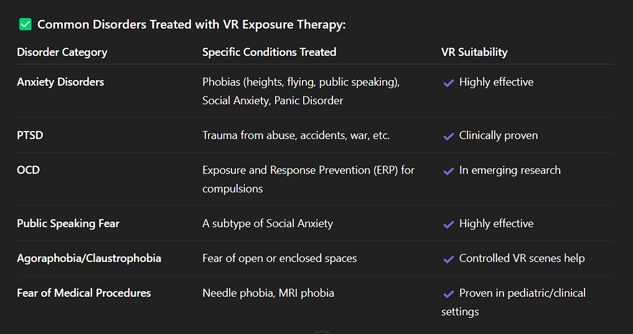

Slide 9
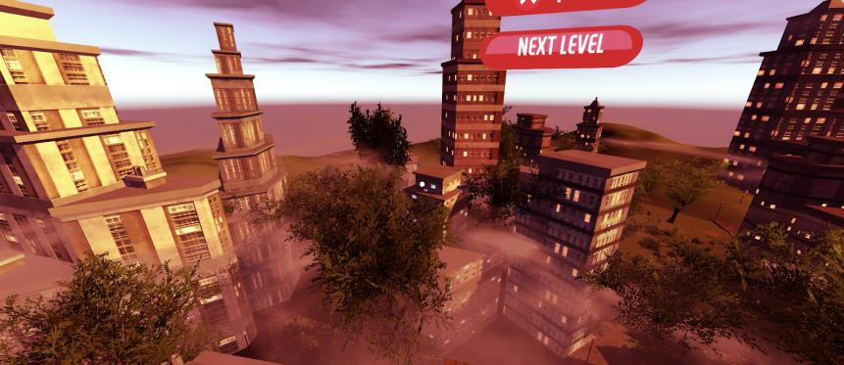

🎮 VR Exposure Therapy
VR Exposure Therapy module for acrophobia
VR - Meditation Module

Slide 10
🤖 AI Conversation Analysis
🧠 Real-Time Mood Detection
AI analyzes user chats and voice inputs to detect emotions (stress, anxiety, calmness)
Uses Natural Language Processing (NLP) for tone, sentiment & language analysis
🎯 Personalized Recommendations
Based on detected mood, the system suggests:
Breathing exercises
Meditation techniques
Peer support or therapist consultation
🛠️ Technology Behind It
Gemini API: Handles chatbot interaction and symptom queries
AI models process user behavior and mood patterns
Improves therapy personalization and intervention timing

Slide 11
💬 Peer Support Integration
🧑‍🤝‍🧑 Safe & Supportive Community
Integrated text and audio chat rooms within the platform
Users can share experiences, seek advice, and offer emotional support
Builds a sense of belonging and reduces loneliness
🔧 Technical Implementation
Powered by Vuplex WebView to embed chatrooms inside VR
Backend: Firebase for user authentication and data management
Frontend: Built using React for seamless user experience
📈 Impact
85% of users reported feeling emotionally supported by peers
Avg. chatroom usage: 15 minutes/day
Increases user retention, trust, and engagement

Slide 12



Technology Stack
🎮 Virtual Reality
Built using Unity 3D for realistic and interactive VR environments
Compatible with Google Cardboard, Oculus, and other VR headsets
Enables immersive phobia simulation and guided meditation
🤖 AI & Chatbots
Gemini API: AI chatbot for symptom discussion and mental support
Uses Natural Language Processing (NLP) for mood and sentiment analysis
Personalized response generation for mental health guidance
💬 Communication & UI
Vuplex WebView: Embeds websites and chatrooms inside VR scenes
Firebase: Handles authentication and real-time database for chatrooms
React: Frontend framework for responsive, modular interface

Slide 13
Current Challenges & Future Scope
❗ Current Challenges
Overwhelming VR environments: Needs careful design to balance realism and comfort
Inaccurate AI sentiment analysis: Limited emotion detection accuracy in diverse user inputs
Limited VR diversity: Fewer scenarios for varied mental health conditions
🔮 Future Improvements
Refine AI models using larger and more diverse emotional datasets
Expand VR scenarios to cover broader phobia types and mental health needs
Adaptive therapy loops: Use AI to dynamically adjust VR difficulty and treatment plans
Enhanced peer support features: Real-time moderator support or expert-led sessions

Slide 14
References
Riva, G. (2005). Virtual reality in psychotherapy: Review. CyberPsychology & Behavior.
Freeman, D. et al. (2017). Automated VR therapy for fear of heights: A RCT. Lancet Psychiatry.
Calvo, R. A., & D’Mello, S. K. (2020). AI in mental health: Opportunities and ethical concerns.
Tutun, S. et al. (2020). Deep learning for mood detection in real-time applications.
Miner, A. S. et al. (2016). Smart therapy: Chatbots in mental health.
SCL-90-R Manual. Derogatis, L. R. (1977). Symptom Checklist Overview.
American Psychiatric Association. (2013). DSM-5: Diagnostic and Statistical Manual of Mental Disorders.

Slide 15
THANK YOU

